Slide 1

Kruskal AlGORITHM
K21-4596 Khubaib Lodhi (Leader)
K21-4549 Aahil Ashiq Ali
K21-3328 Khuzaima Ahsan

Slide 2

Kruskal Algorithm is a greedy algorithm used for finding the minimum spanning tree of a connected, weighted graph. It works by sorting the edges of the graph in non-decreasing order of their weights and adding them to the minimum spanning tree if they do not form a cycle. The algorithm terminates when all vertices are in the same set or there are no more edges left.

Slide 3



Slide 4
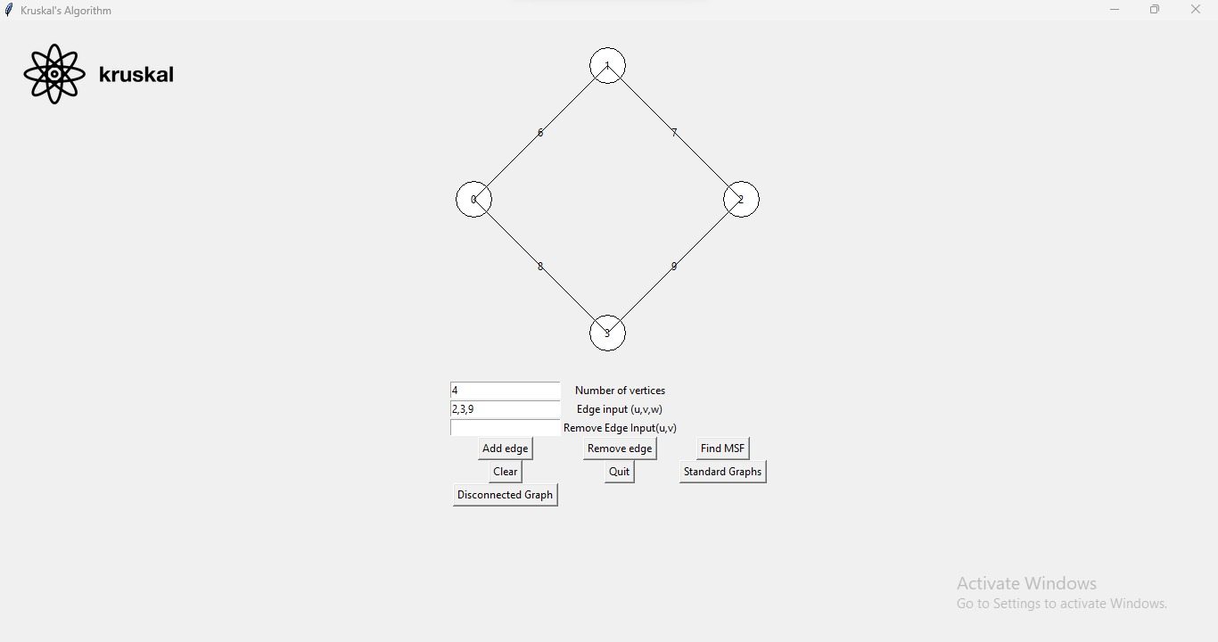
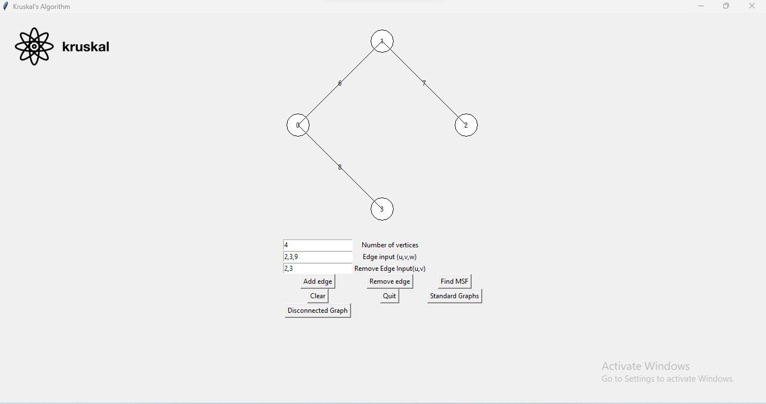
Add edge
remove edge

Slide 5
Minimum spanning tree
The Kruskal algorithm is a popular algorithm for finding the minimum spanning tree of a connected graph. It is a greedy algorithm that works by adding edges to the tree one at a time, in non-decreasing order of their weights. The algorithm starts with an empty tree and adds edges to the tree one at a time, as long as the sum of the weights of the edges added so far is less than or equal to the weight of the next edge. Once all edges have been added, the resulting tree is the minimum spanning tree of the graph.

Slide 6
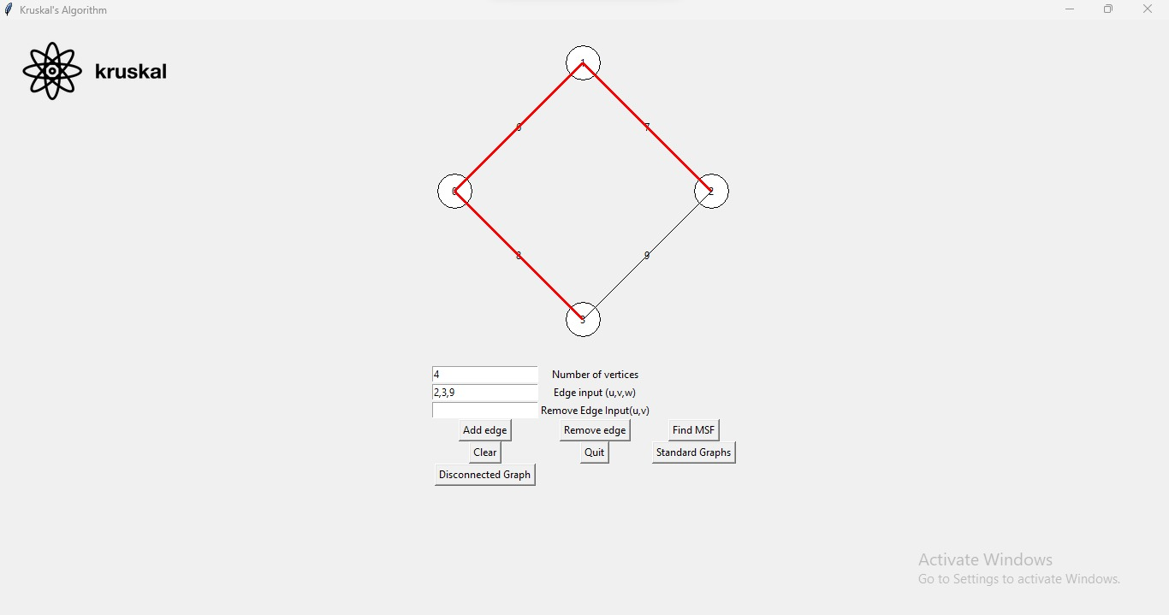
Minimum Spanning Tree

Slide 7
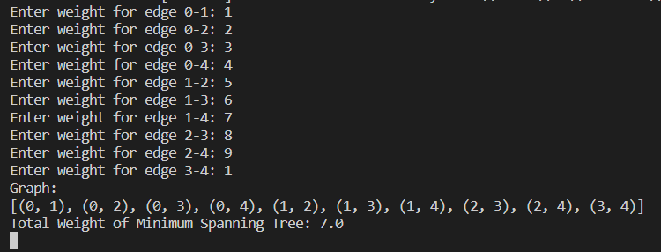

Minimum Spanning Tree standard graph

Slide 8
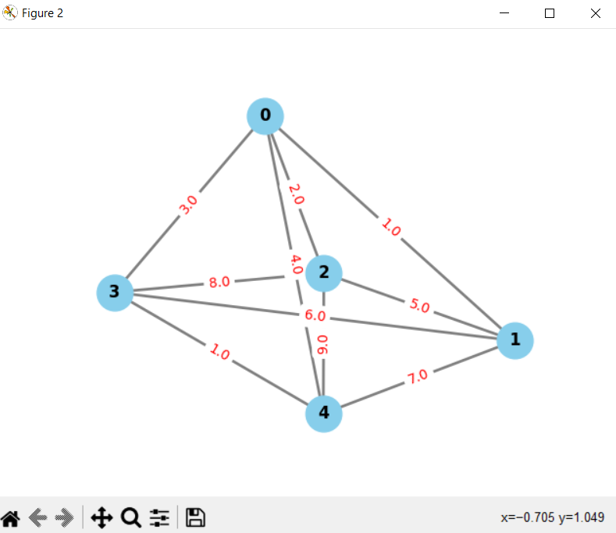
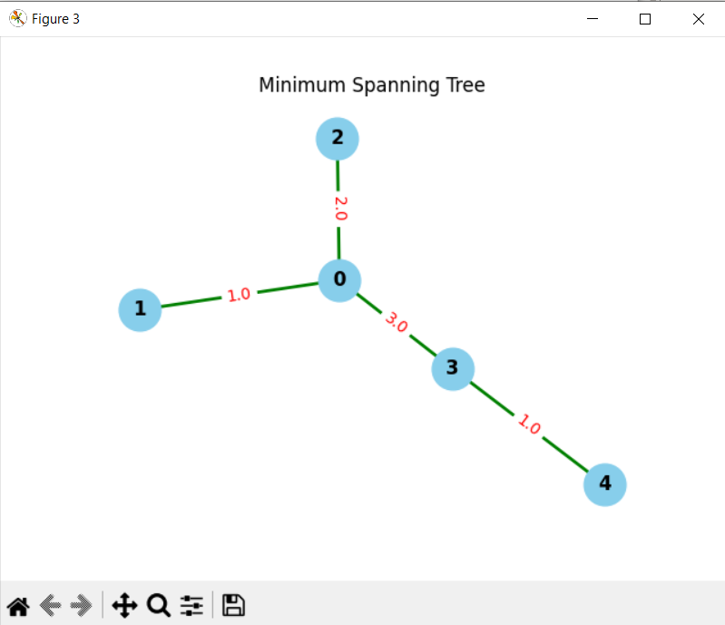
Minimum Spanning Tree standard graph
Complete graph
Kruskal

Slide 9
Minimum Spanning Tree disconnected graph
In a disconnected graph, the minimum spanning tree will have multiple components. The algorithm works by sorting all the edges in the graph by weight and then adding them to the minimum spanning tree one by one, as long as they do not create a cycle. In a disconnected graph, this process will result in multiple minimum spanning trees, one for each component.

Slide 10
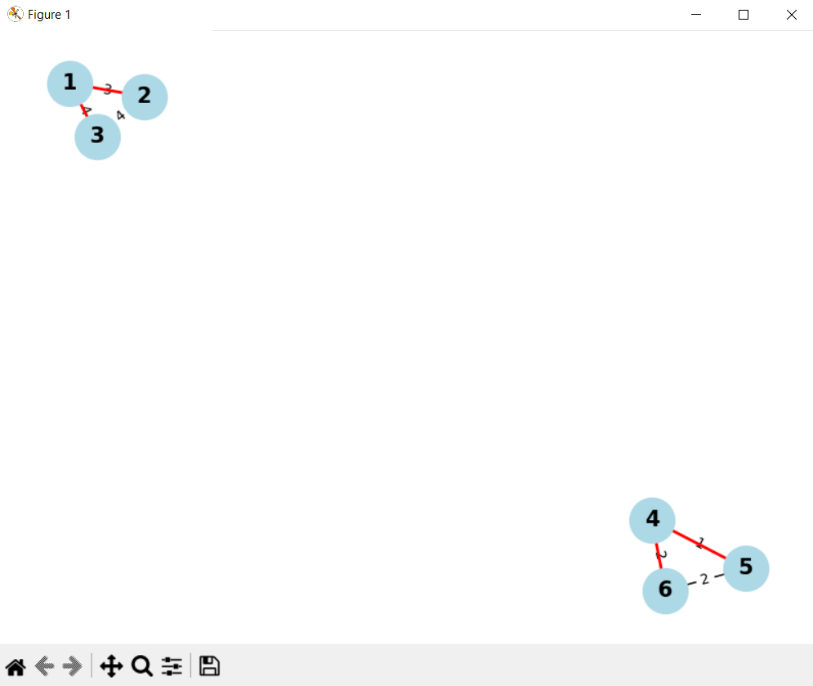
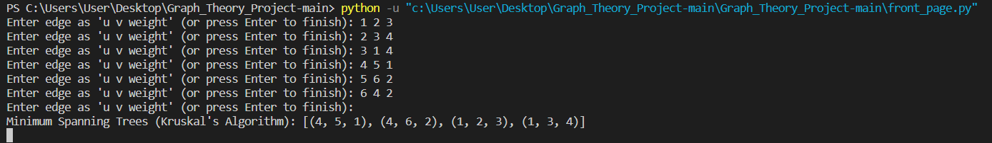
Minimum Spanning Tree disconnected graph

Slide 11
Maximum Spanning Tree
The Kruskal algorithm is a popular algorithm for finding a maximum spanning tree in a connected and disconnected graph. It works by sorting the edges of the graph by their weights and then adding them to the tree in non-decreasing order

Slide 12
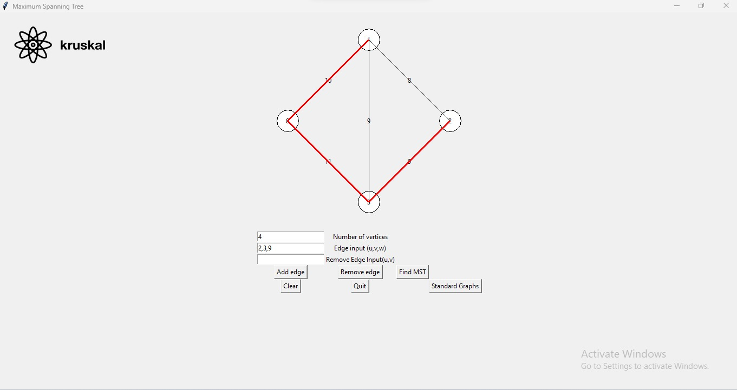
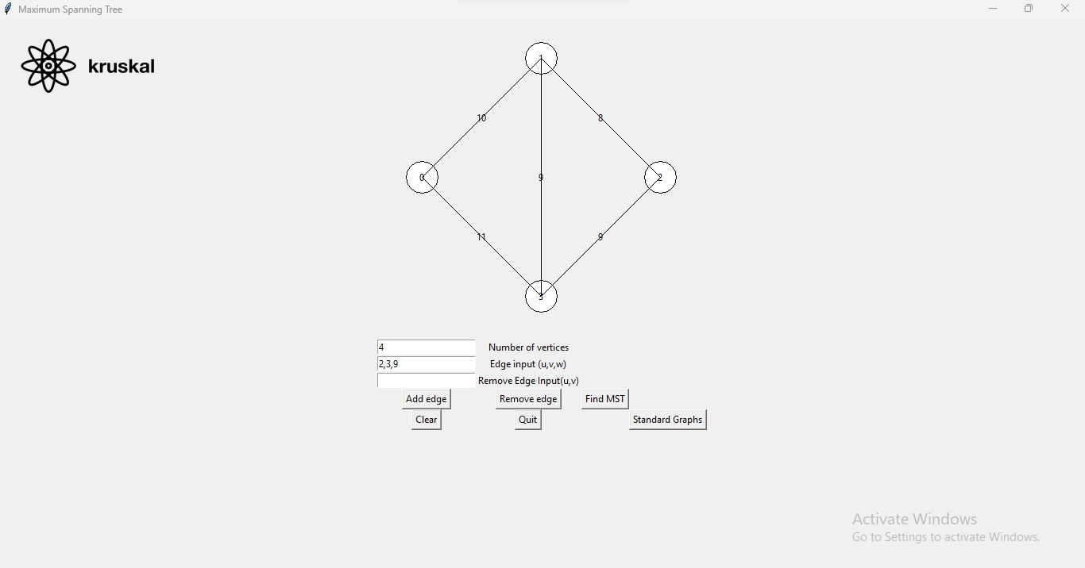
Maximum Spanning Tree

Slide 13
Maximum Spanning Tree standard graph

Slide 14
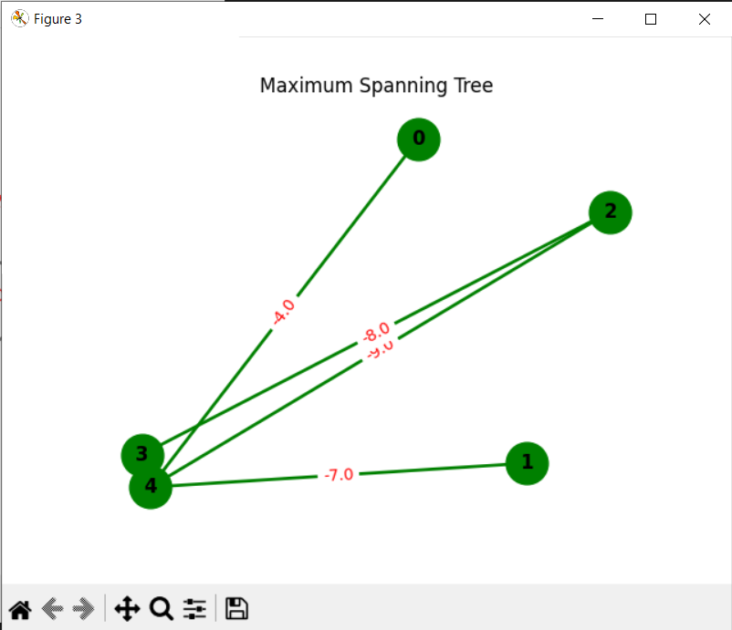
MAXimum Spanning Tree standard graph
Complete graph
Kruskal

Slide 15
Time complexity
The time complexity of Kruskal Algorithm is O(E log E) or O(E log V), where E is the number of edges and V is the number of vertices in the graph. This makes Kruskal Algorithm an efficient algorithm for finding the minimum spanning tree of a connected or disconnected graph.

Slide 16


Closing prompt

